Slide 1
Ch9 Design Patterns(1)
——Programming to Interfaces
——OCP
Software System Design and Architecture
Ding Er-Yu
Software Institute, Nanjing University

Slide 2
Main Contents
Design patterns
Programming to Interfaces
OCP

Slide 3
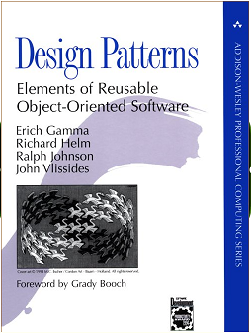
What is a Design Pattern?
A design pattern
  abstracts a recurring design structure
  comprises class and/or object
    dependencies,
    structures,
    interactions, or
    conventions
  distills design experience

Slide 4
Elements of Design Patterns
Design patterns have 4 essential elements:
  Pattern name: increases vocabulary of designers
  Problem: intent, context, when to apply
  Solution: UML-like structure, abstract code
  Consequences: results and tradeoffs

Slide 5
Main Contents
Design patterns
Programming to Interfaces
OCP

Slide 6
Programming to Interfaces, not Implementations
“Connections that address or refer to a module as a whole by its name yield lower coupling than connections referring to the internal elements of another module”

Slide 7
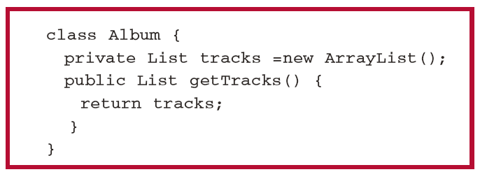
Single values VS a collection of values
Take Care Friend methods and References
Share Data !

Slide 8
Iterator Pattern
《Abstraction Mechanisms in CLU》, Liskov, 1977
Intent
Provide a way to access the elements of an aggregate object sequentially without exposing its underlying representation.
Supports multiple traversals of aggregate objects.
Provides a uniform interface for traversing different aggregate structures (it supports polymorphic iteration).

Slide 9
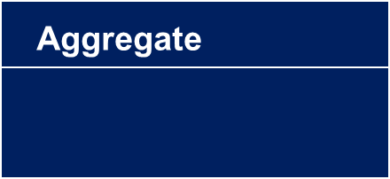
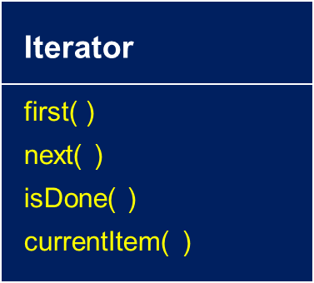



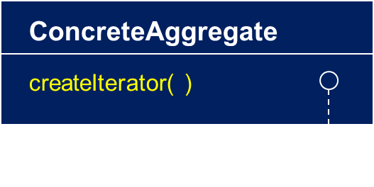


Iterator Pattern
Structure
createIterator( )
//client code
Aggregate myList = new ConcreteAggregate( );
Iterator itr = myList.createIterator( );

Slide 10
Iterator Pattern
Consequences
Programming to interfaces and Information Hiding
It supports variations in the traversal of an aggregate. For example, code generation may traverse the parse tree inorder or preorder. Iterators make it easy to change the traversal. Just replace the iterator instance with a different one.
Iterators simplify the Aggregate interface. Iterator’s traversal interface obviates the need for a similar interface in Aggregate.
More than one traversal can be pending on an aggregate.

Slide 11
The Proxy Pattern: Solution
Subject
{abstract}
Client
Request()
RealSubject
Proxy
refers to
->Request()
Request()
Request()

Slide 12
The Proxy Pattern
The Problem
  Provide a surrogate or placeholder for another object to control access to it
Remote Proxy: provide local representative for object in different address space, may re-code request.
Virtual Proxy: creates expensive objects on demand, like in example, may also cache.
Protection Proxy: control access to original object, useful when access rights differ.

Slide 13
The Proxy Pattern Consequences
The Proxy pattern introduces a level of indirection when accessing an object:
  A remote proxy can hide the fact that the object resides in a different address space
  A virtual proxy can perform optimisations
  –Allow additional housekeeping

Slide 14
Prototype Pattern
Classification Class , Prototype Class
Specify the kinds of objects to create using a prototypical instance, and create new objects by copying this prototype

Slide 15
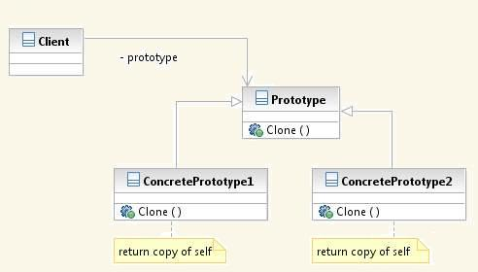
Prototype Pattern UML
Participants:
• Prototype
o declares an interface for cloning itself.
• ConcretePrototype o implements an operation for cloning itself.
• Client
o creates a new object by asking a prototype to clone itself.

Slide 16
Let’s Try!

Slide 17
思考题
有一个数据列表DataList，其基本类型是3维向量ThreeD<x,y,z>
  1）用Java语言实现该数据列表的数据结构
假设有三个外部对象A,B,C，分别对其x、y、z维度感兴趣，希望访问DataList在相应维度的数据并进行处理
  2）请定义其对外的数据接口
    分别使用迭代器与Proxy

Slide 18
Main Contents
Design patterns
Programming to Interfaces
OCP

Slide 19
OCP
Function of Inheritance
  Incremental development
    《Data Abstraction and Hierarchy》, Liskov
  Modify closed, increment easier
    《On the Notion of Inheritance》，ANTERO TAIVALSAARI
After 1990s, requirements changed become critical
  OCP (depend DIP)

Slide 20
Open/Closed Principle (OCP)
Software entities should be open for extension,
but closed for modification
B. Meyer, 1988 / quoted by R. Martin, 1996
Be open for extension
  module's behavior can be extended
Be closed for modification
  source code for the module must not be changes
There is no 100% OCP!

Slide 21
A Simple Example of OCP
enum OutputDevice {printer, disk};
void Copy(ReadKeyboard& r, WritePrinter& wp, WriteDisk& wd, OutputDevice dev){
int c;
while((c = r.read())!= EOF)
if(dev == printer)
wp.write(c);
else
wd.write (c);
}
Copy
Read
Keyboard
Write
Printer
Write
Disk
void Copy(ReadKeyboard& r, WritePrinter& w){
int c;
while ((c = r.read ()) != EOF)
w.write (c);
}

Slide 22
A Simple Example of OCP
Copy
DiskWriter::Write(c)
{
WriteDisk(c);
}
Keyboard
Reader
Printer
Writer
Disk
Writer
void Copy(ReadKeyboard& r, WritePrinter& w){
int c;
while ((c = r.read ()) != EOF)
w.write (c);
}

Slide 23
思考题
VisualComponent
draw()
resize()
TextView
draw()
resize()
SteamedVideoView
draw()
resize()
Extension:
  Border( Plain, 3D, Fancy)
  ScrollBar( Horiz, Vert)
  ….

Slide 24
The Decorator Pattern: Problems
Decorators expand the functionality of an instance of a class without changing the class code
    Add borders or scrollbars to a GUI component
      Adding items such as scroll bars as needed provides more flexibility than requiring all windows to have scroll bars
    Add headers and footers to an advertisement
    Add stream functionality such as reading a line of input or compressing a file before sending it over the wire
More flexibility than static inheritance
Decorators work behind the scenes, they are transparent to the interface
Notes:
It attaches additional responsibilities to an object dynamically at run time. If we use inheritance, then every object of that class will have that inherited responsibility. It is not possible to have one object adopt a responsibility while another object of the same class opt out of it.
The presence of decorators is transparent to the component it decorates. This transparency allows us to nest decorators recursively, thus allowing an unlimited number of added responsibilities.

Slide 25
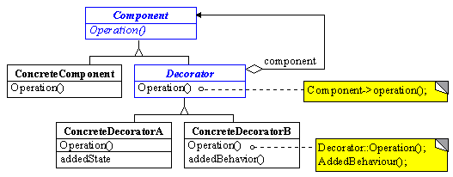
The Decorator Pattern: The Solution

Slide 26

VisualComponent
draw()
resize()
1
TextView
draw()
resize()
SteamedVideoView
draw()
resize()
Decorator
draw()
resize()
1
Decorator contains a visual component
Border
draw()
resize()
ScrollBar
draw()
resize()
Plain
draw()
resize()
3D
draw()
resize()
Fancy
draw()
resize()
Horiz
draw()
resize()
Vert
draw()
resize()

Slide 27
The Decorator Pattern: Consequences
More flexible than static inheritance
Avoids feature laden classes high up in hierarchy
Lots of little objects that look alike. So it is hard to learn and debug
A decorator and its components are not identical. So checking object identification can cause problems
Notes:
2. Instead of trying to support all forseable features in a complex, customizable class, you can define a simple class and add functionality incrementally with Decorator objects.

Slide 28
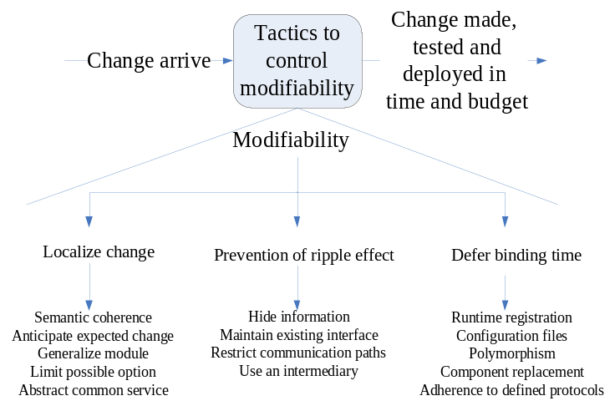
Modifiability Tactics
Defer binding time
  Dynamic Binding: Polymorphism
    allows late binding of method calls
  Runtime registration: Event Style
    supports plug-and-play operation at the cost of additional overhead to manage the registration
  Startup binding: Configuration files
    set parameters at startup
  Load Binding: Component replacement
    load time binding
  Adherence to defined protocols
    runtime binding of independent processes

Slide 29
Any question?

